Slide 1

CS 533 INTRO TO DATA SCIENCE
Michael Ekstrand

Slide 2
TUNING HYPERPARAMETERS

Slide 3

Learning Outcomes
Apply different techniques to tune hyperparameters
Understand the principle of random search
Photo by Marten Newhall on Unsplash

Slide 4
Selecting Hyperparameters
Need to pick good values for hyperparameters
Regularization strength
Number of trees in the forest
Number of neighbors
Latent space dimensionality

Slide 5
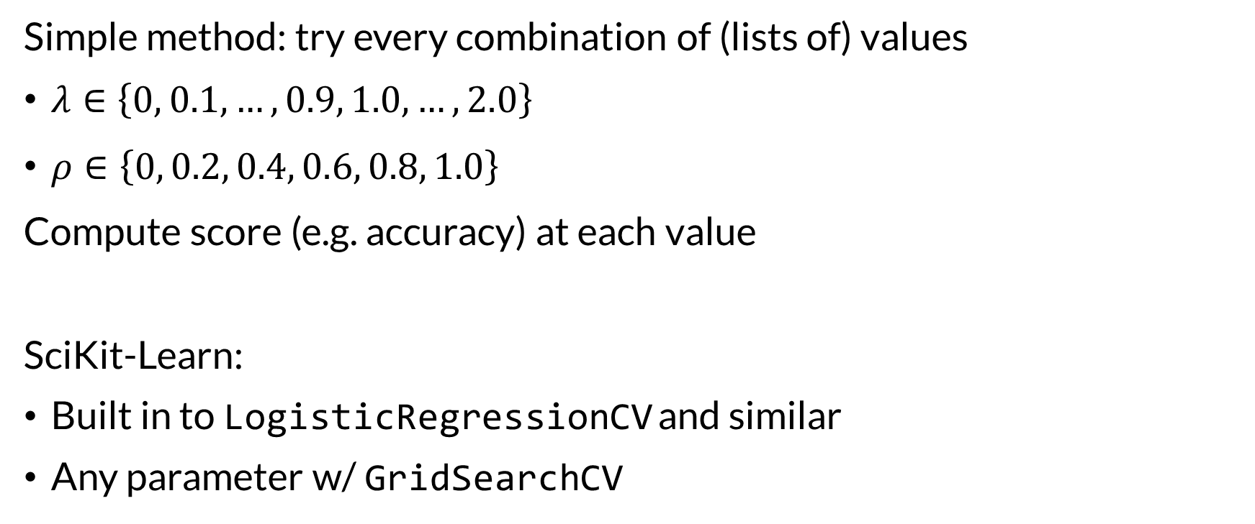
Grid Search
Simple method: try every combination of (lists of) values
$λ∈\left\{0, 0.1, …, 0.9, 1.0, …, 2.0\right\}$
$ρ∈\left\{0, 0.2, 0.4, 0.6, 0.8, 1.0\right\}$
Compute score (e.g. accuracy) at each value
SciKit-Learn:
Built in to LogisticRegressionCV and similar
Any parameter w/ GridSearchCV

Slide 6
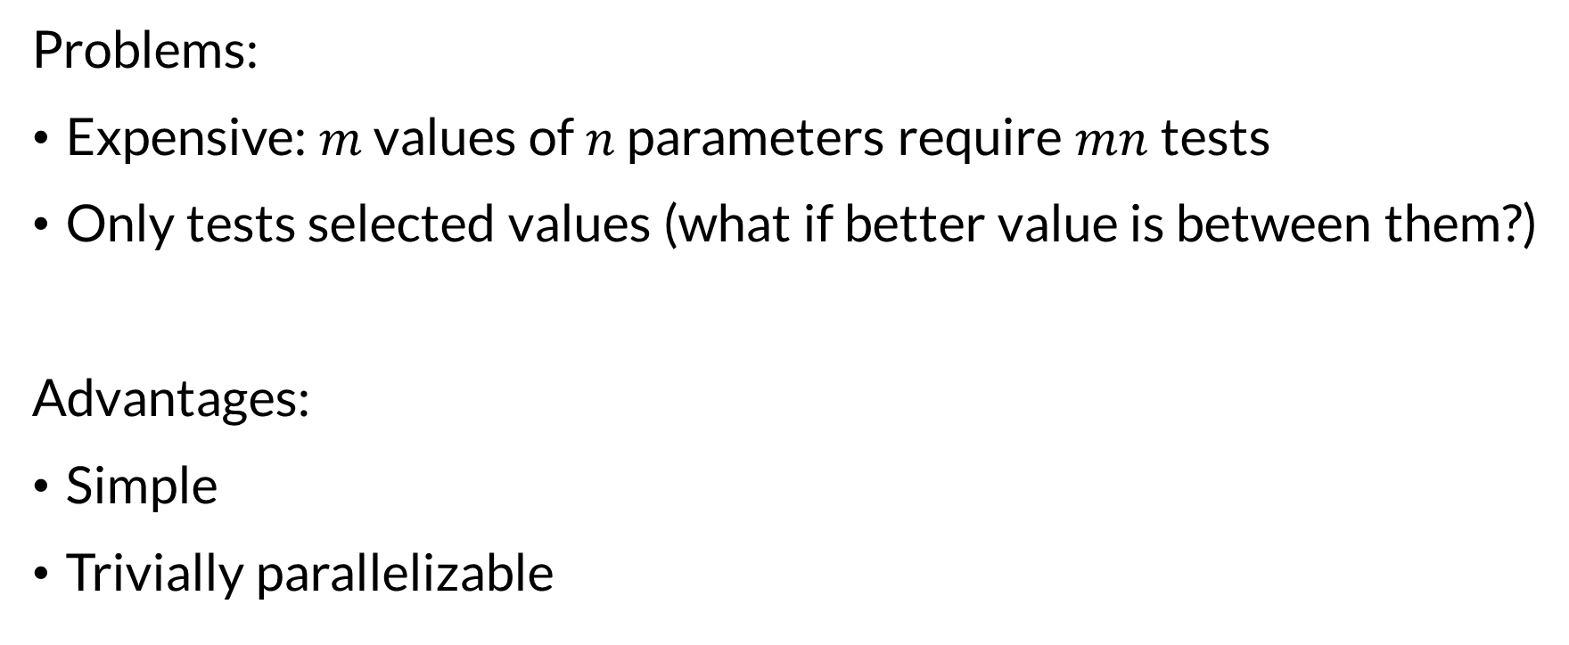
Characteristics of Grid Search
Problems:
Expensive: $m$ values of $n$ parameters require $mn$ tests
Only tests selected values (what if better value is between them?)
Advantages:
Simple
Trivially parallelizable

Slide 7
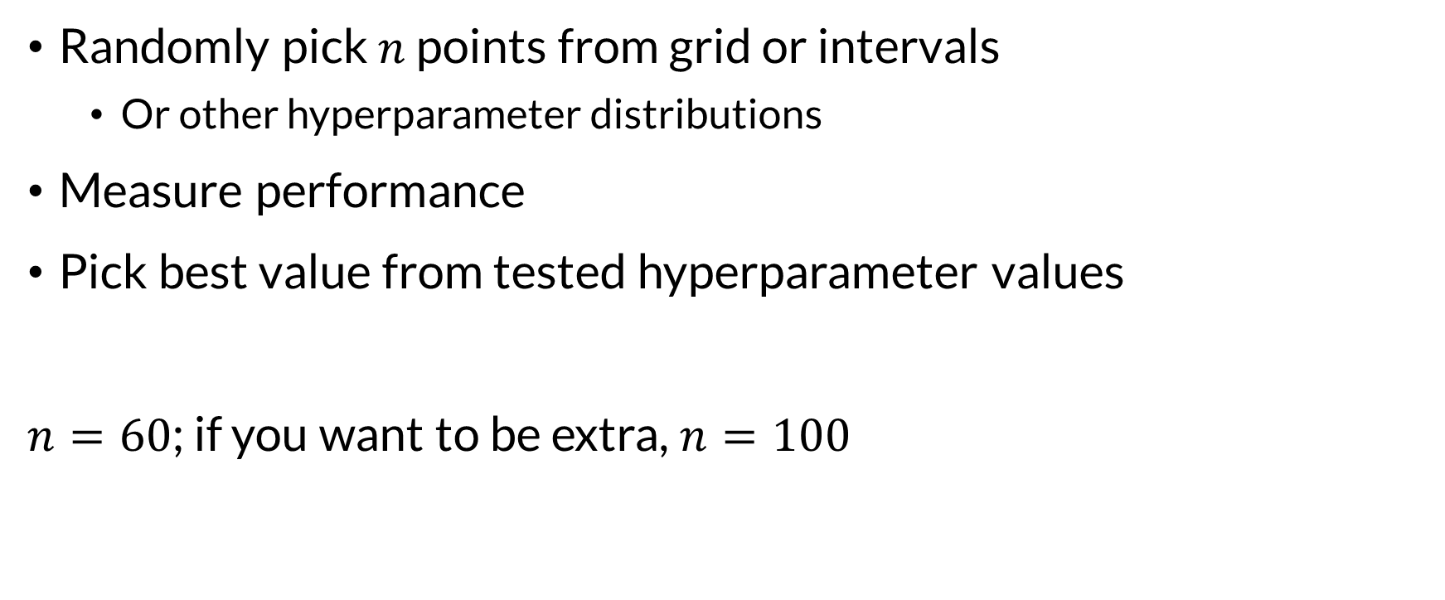
Random Search
Randomly pick $n$ points from grid or intervals
Or other hyperparameter distributions
Measure performance
Pick best value from tested hyperparameter values
$n=60$; if you want to be extra, $n=100$

Slide 8

Why Does Random Search Work?
Principle 1: we don’t need best, just good enough
Principle 2: more than one setting probably good enough
If 5% of the search space is “good enough”
And you sample 60 points
Probability you have at least 1 good-enough point: 95%
G

Slide 9
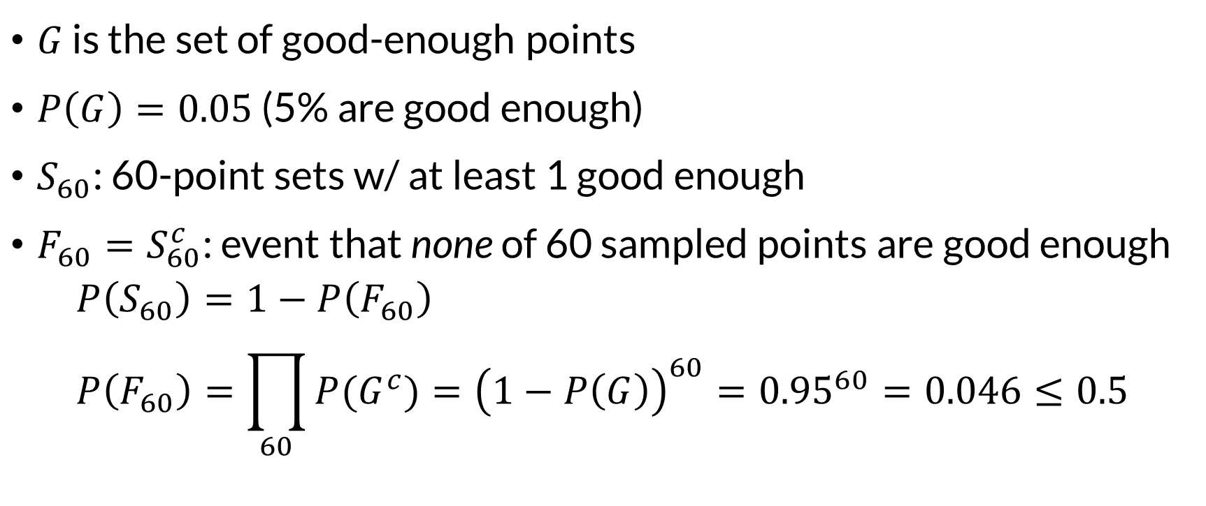

Proof
$G$ is the set of good-enough points
$P\left(G\right)=0.05$ (5% are good enough)
$S_{60}$: 60-point sets w/ at least 1 good enough
$F_{60}=S_{60}^{c}$: event that none of 60 sampled points are good enough
$$P\left(S_{60}\right)=1−P\left(F_{60}\right) \\ P\left(F_{60}\right)=\prod_{60}{P(G^{c})}={\left(1−P\left(G\right)\right)}^{60}={0.95}^{60}=0.046≤0.5$$
G

Slide 10
Random Search Summary
Only needs 60-100 points, regardless of # of parameters
Trivially parallelizable (like grid search)
May not find best solution
Requires assumption about size of “good enough” set
SciKit Learn: RandomizedSearchCV

Slide 11
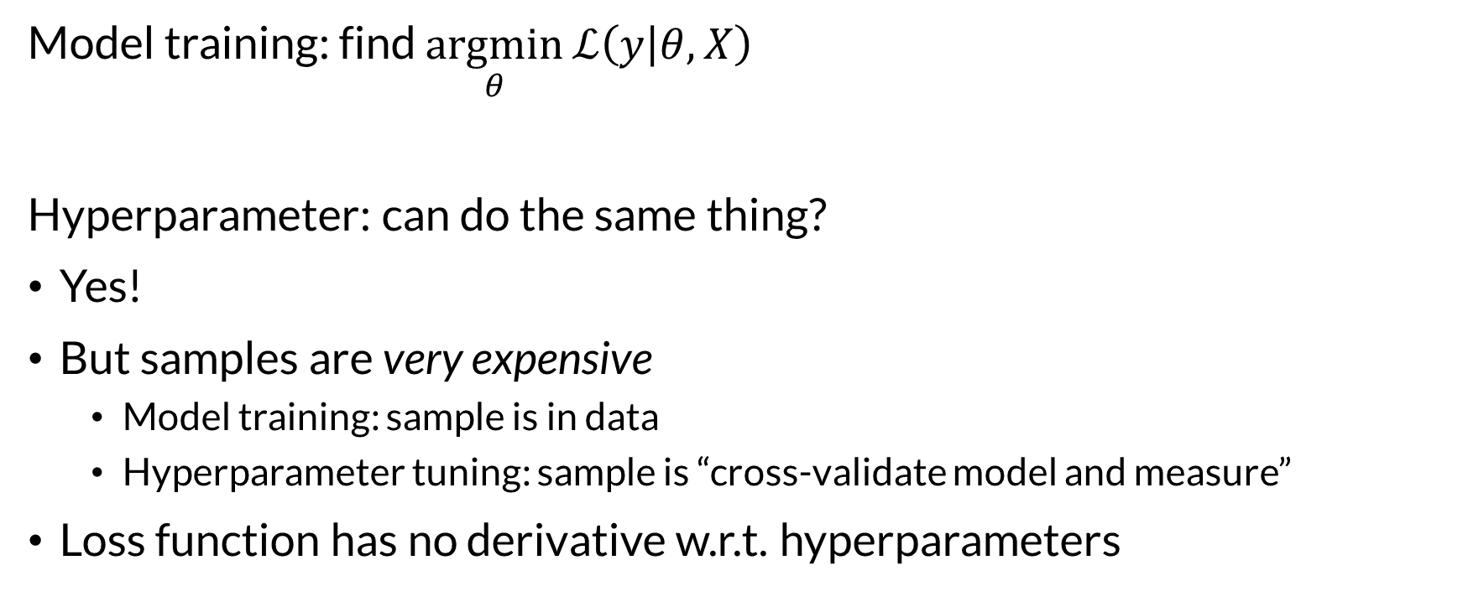
Hyperparameter Search as Optimization
Model training: find $\underset{θ}{argmin}{ℒ\left(y | θ,X\right)}$
Hyperparameter: can do the same thing?
Yes!
But samples are very expensive
Model training: sample is in data
Hyperparameter tuning: sample is “cross-validate model and measure”
Loss function has no derivative w.r.t. hyperparameters

Slide 12
Bayesian Optimization
Tests model at a few initial points
Maintains surrogate model to predict performance at new settings
Uses model to pick next test points
Implemented by scikit-optimize.
BayesSearchCV: SciKit-compatible optimizer
gp_minimize: general-purpose function minimizer

Slide 13
Bayesian Optimization Characteristics
Trades off parallelism for optimization ability
Next search point(s) depend on results so far
Can batch searches (e.g. try 4 new points instead of 1)
Useful for complex search spaces if random isn’t good enough
Can be more efficient than random w/ early stopping

Slide 14
In a Workflow
We’ve been using CV to search while we run
I often use a hyperparameter search script
Runs tuning on training data
Saves optimal parameter values to a file (e.g. JSON file)
Later scripts read & use settings

Slide 15

Wrapping Up
Hyperparameter tuning is an expensive optimization problem.
Several techniques are useful, with good automation for scikit-learn.
Photo by Clem Onojeghuo on Unsplash

